Slide 1
Learning Reflection Platform
Presented By
Amita Kumari EN23CS301121
Anaaya Bhattacharya EN23CS301123
Anjali Gour EN23CS301136
Guided By
Prof. Deepika Saraswat
Prof. Jyotsana Goyal

Slide 2
Contents
Introduction
Literature Review
Problem Definition
Objectives
Methodology
Societal impact or benefits to society.
Conclusion
References

Slide 3

Introduction
In today’s digital era, students consume learning content from multiple sources such as YouTube, blogs, documentation websites, and shared links YouTube
Often, students are unable to fully understand a concept immediately due to:
Time constraints
Lack of prerequisites
Cognitive overload
These resources are saved with the intention of revisiting them later.
However, there is no structured mechanism to track conceptual understanding or readiness.
Learning Reflection Platform is designed to solve this problem by focusing on learning clarity rather than task completion.

Slide 4
Literature Review
1. Task Management Platforms (Todo list, Notion)
Organize tasks and deadlines
Focus on completion tracking
Do not support conceptual understanding or learning clarity
2. Learning Management Systems (LMS) (Moodle, Google Classroom)
Structured course delivery & assessments
Institution-controlled platforms
Limited support for self-directed external learning resources
3. Reflective & Self-Regulated Learning
Research highlights importance of metacognition & reflection
Tracking conceptual clarity improves retention & exam readiness
No structured tool for managing unresolved learning concepts
Identified Gap
Existing tools either:
Manage tasks or Deliver content
⚠️ But they do not support structured tracking of unresolved learning items in self-directed learning.

Slide 5
Problem Definition
In today’s digital learning environment, students use multiple platforms (YouTube, blogs, documentation, shared links).
Challenges
Time constraints
Lack of prerequisites
Cognitive overload
Poor organization
Students save resources to revisit later, but:
Links get scattered
Unresolved concepts are forgotten
No structured clarity tracking
Tools focus on task completion, not understanding
No system to prioritize before exams/interviews
Result
Important concepts remain partially understood or forgotten, affecting academic performance and preparation readiness.

Slide 6
Objectives
The main objectives of the Learning Reflection Platform are:
Provide a centralized platform for managing learning resources
Track learning progress based on clarity:
Confused
Partially Clear
Clear
Allow users to set target readiness dates
Encourage reflective learning through difficulty identification
Provide reminder mechanisms
Track interaction and revisit frequency

Slide 7
Methodology 1. Development Approach
The Learning Reflection Platform will follow a modular and incremental development approach.
The system will be divided into independent modules.
Each module will be designed, implemented, and tested separately.
Integration will be performed after validating individual components.
This approach will ensure scalability, maintainability, and structured growth of the system.
Proposed modules include:
User Authentication Module
Learning Item Management Module
Metadata Extraction Module
Reminder & Priority Evaluation Module
Interaction Tracking Module

Slide 8
Methodology 2. System Architecture
The platform will follow a Client–Server Architecture.
Frontend Layer:
Will be developed using HTML5, CSS3, JavaScript, and React.js.
Responsible for user interface, dashboards, and interaction controls.
Backend Layer:
Will be built using Node.js and Express.js.
Responsible for business logic, API handling, and data processing.
Database Layer:
MongoDB will be used for storing user data and learning items.
Mongoose will define structured schemas.
Communication between frontend and backend will occur through REST APIs using JSON-based HTTP requests.

Slide 9
Methodology 3. Functional Workflow
The proposed system workflow will be:
Users will register and log into the platform.
Users will add learning resource links.
The backend will process the link and extract metadata.
Learning items will be stored in the database.
Users will set clarity level, difficulty reasons, priority, and readiness date.
The system will evaluate deadlines and generate reminders.
User interactions (such as link visits) will be tracked for analysis.
This workflow ensures structured learning reflection rather than simple task tracking.

Slide 10
Societal impact or benefits to society
1. Promotes Structured Learning Habits
The platform encourages students to:
Reflect on what they do not understand
Track conceptual clarity
Revise before important deadlines
2. Supports Self-Directed Education
With the rise of online learning platforms such as YouTube, Coursera, and Udemy, students increasingly learn independently. This platform helps to manage resources efficiently.
3. Reduces Learning Gaps
By tracking:
Confusion levels
Difficulty reasons
Readiness deadlines
4. Encourages Reflective Thinking
The system applies principles of self-reflection, metacognition, and active learning. Students move from passive content consumption to active understanding evaluation. This improves long-term retention.
5. Improves Academic & Career Preparedness
By setting readiness deadlines for:
Exams
Competitive tests
Job interviews Students prepare in a structured and timely manner.
6. Digital Organization & Productivity Enhancement
The platform reduces:
Scattered saved links
Forgotten bookmarks
Unused study materials

Slide 11
Conclusion
The Learning Reflection Platform addresses a critical gap in modern digital education by focusing not on task completion, but on conceptual understanding and reflective learning.
In today's environment, students consume large amounts of online educational content but lack a structured way to track what they do not understand. Existing systems either manage tasks or deliver content, but do not support clarity tracking and learning reflection.
Platform Provisions
This platform provides:
Centralized management of learning resources
Clarity-based progress tracking
Difficulty reflection mechanisms
Priority and readiness-based reminders
Interaction tracking for accountability
Student Benefits
By integrating structured organization with reflective learning principles, the system helps students:
Reduce conceptual gaps
Improve exam and interview readiness
Develop disciplined and self-regulated learning habits

Slide 12
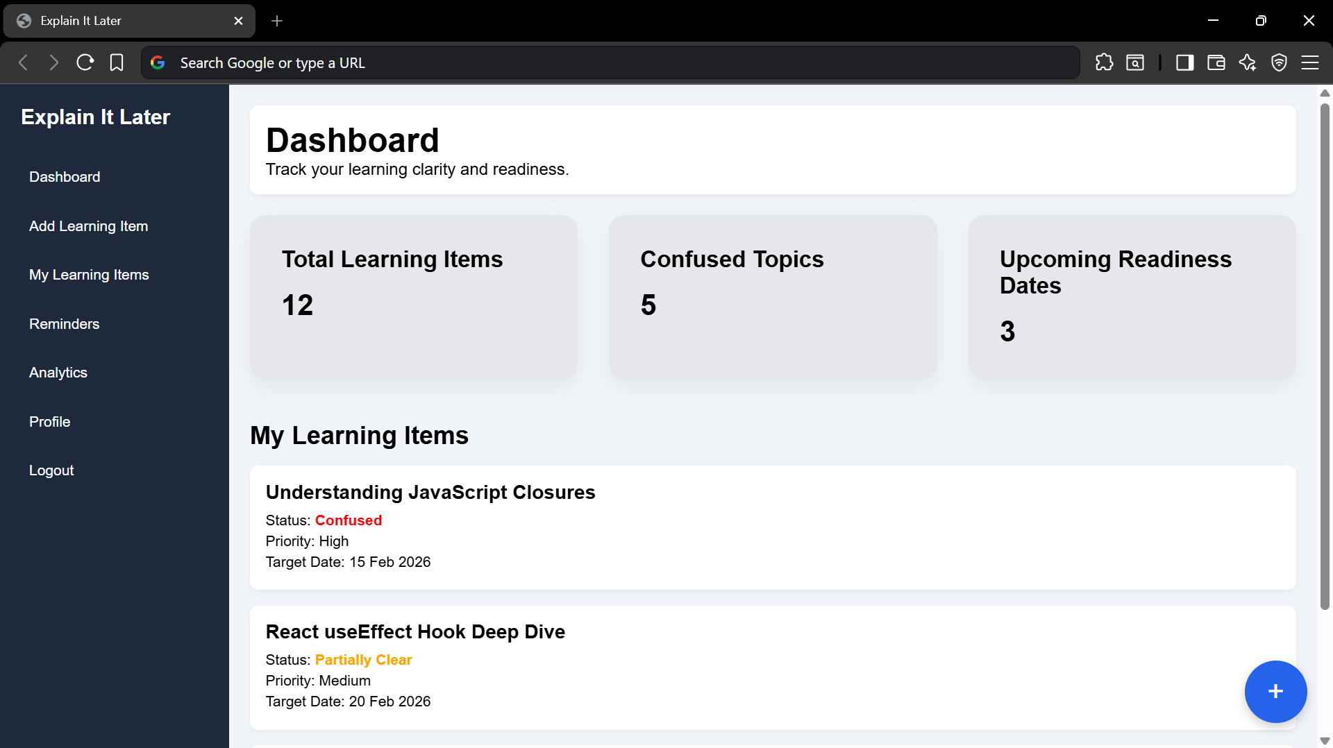
Sample Template

